Slide 1
City Dashboard Pitch
Nicholas Mattei, Max Motz, Carly Presz, Rafaela Hojda, Evan Hendrickson, Julian Esparza

Slide 2
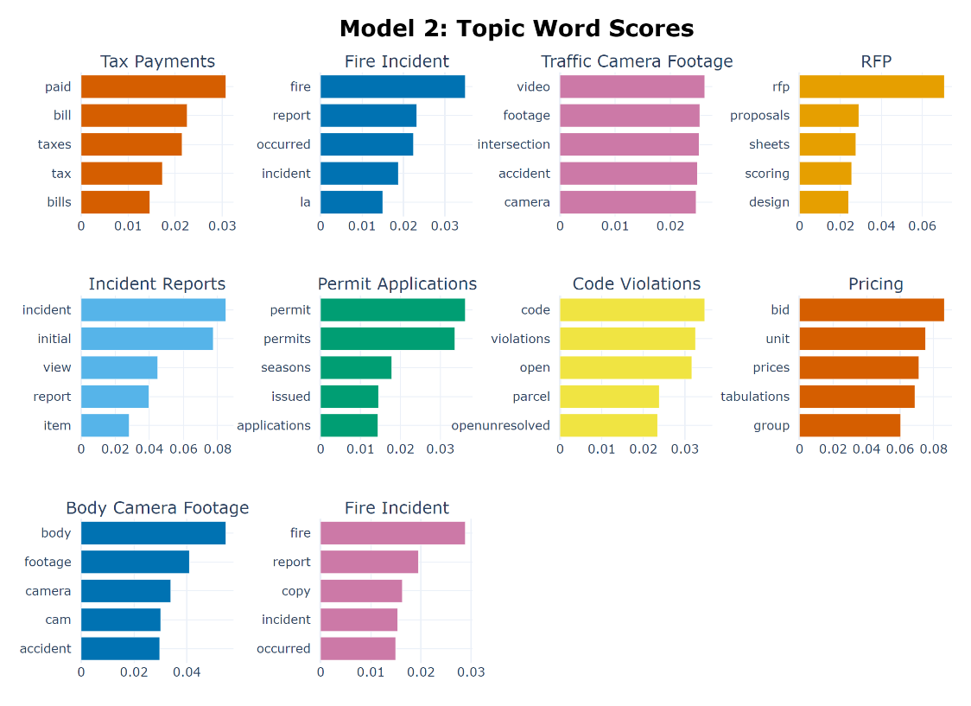
Public Record Requests - Frequent Topics
Lots of requests related to:
Fire incident reports
Traffic camera footage / tickets
Crime / NOPD
Tax Bills
Many requests for sensitive and/or inaccessible data
Traffic data is a plausible, interesting potential topic for our final product
An interesting traffic-related request:
"I am requesting the demographic breakdowns – race, age, sex -- of all people issued traffic tickets by automated traffic cameras in 2016, 2017, 2018 and 2019. I would also like the total number of tickets issued and the total dollar amount of those tickets."

Slide 3
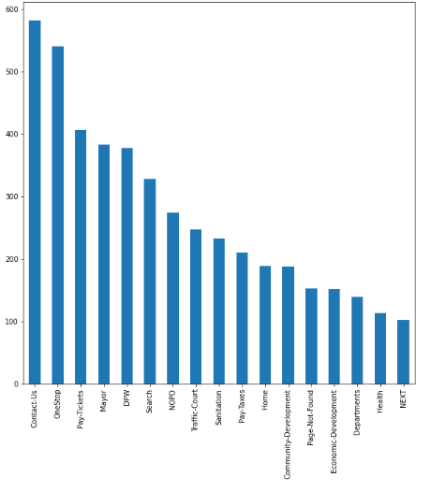
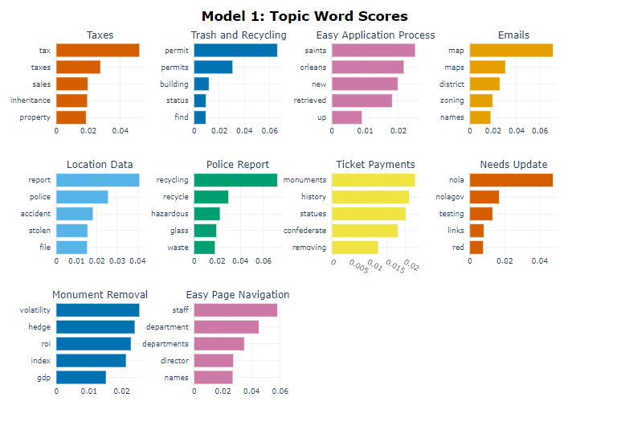
“Was This Page Helpful” Most Frequent Topics
Notes:
In addition to doing analysis on datasets on datasets on the site, we conducted data analysis and NLP topic modeling on the “Was this page helpful?” prompt data sent to us.
On the left: Most common sections people had a negative response to
On the right: Results of 1 of the 4 Topic models (most common aggregate of words

Slide 4
“Was This Page Helpful” Conclusion
Most Frequent Topics from Modeling:
Ticket Payments
Waste Disposal (Trash and Recycling)
Obtaining/Renewing Permits
Government Officials
Monument Removals
A lot of people filling it out are having trouble with specific NOLA government processes.
While some of these problems lie out of our jurisdiction, identifying the most pertinent and consistent through data analysis would help anyone looking to address them.
Notes:
1st bullet: I.E.: People having trouble paying for their tickets would respond to the “Was This Page Helpful Prompt” by complaining about their troubles.
2nd bullet: While some problems are out of our scope, identifying them is helpful to anyone whose scope they are in and could even lead to problems we would be able to address.

Slide 5
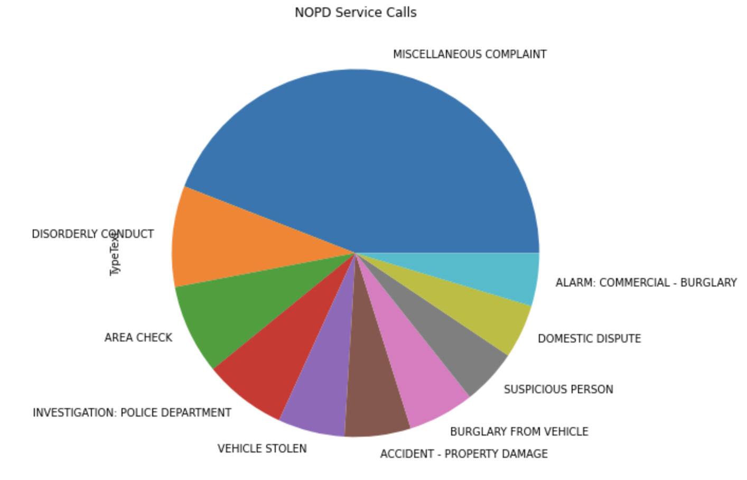
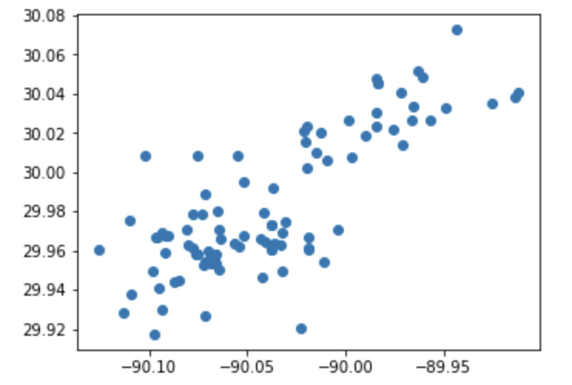
Calls for Service 2023
Imported Calls for Service 2023 Dataset
Includes several topics but focus on:
Type of service needed from NOPD
Location of call
Ran value count on data and found several calls for miscellaneous complaints, disorderly conduct, and area check
Want to analyze data to see if there is correlation between location of crime and crime committed in New Orleans

Slide 6
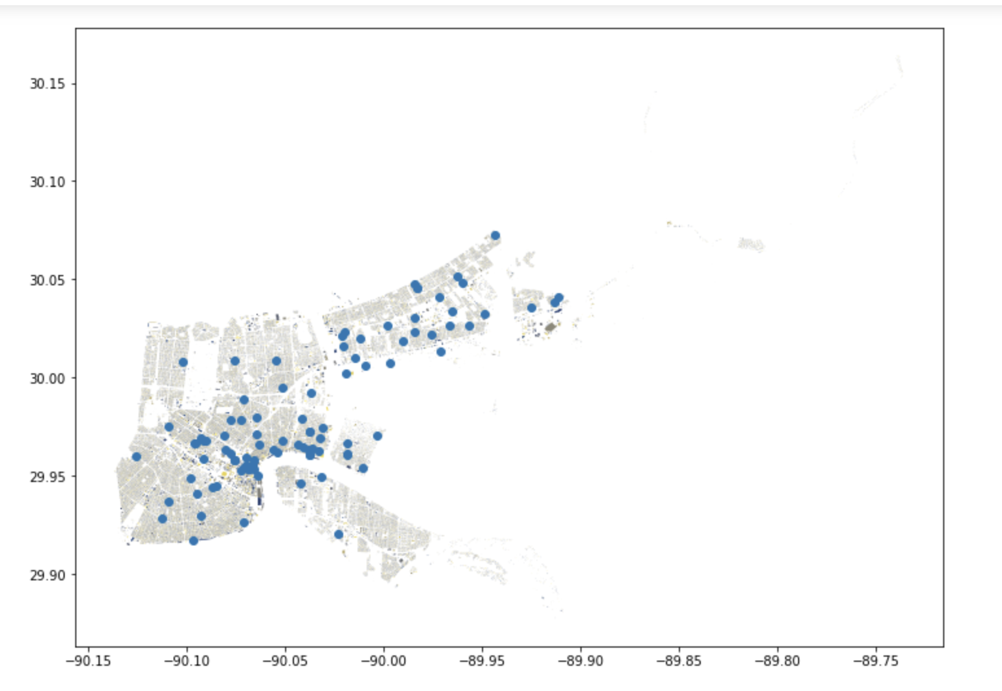
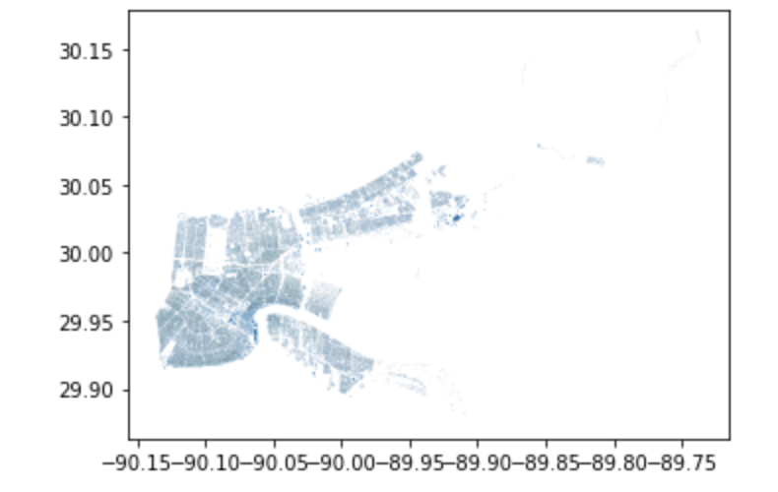
Calls for Service 2023 cont.
Map Geospatial Data of Calls for Service using a map of New Orleans

Slide 7
Dashboard Pitches
NOPD Misconduct Complaints Data
View officer/complainant race, gender, the type of violation, etc.
Toggle year
Traffic Ticket Data
View race, age, sex of all people issued traffic tickets by NOPD officers
Total number of tickets issued
Total dollar amount

Slide 8
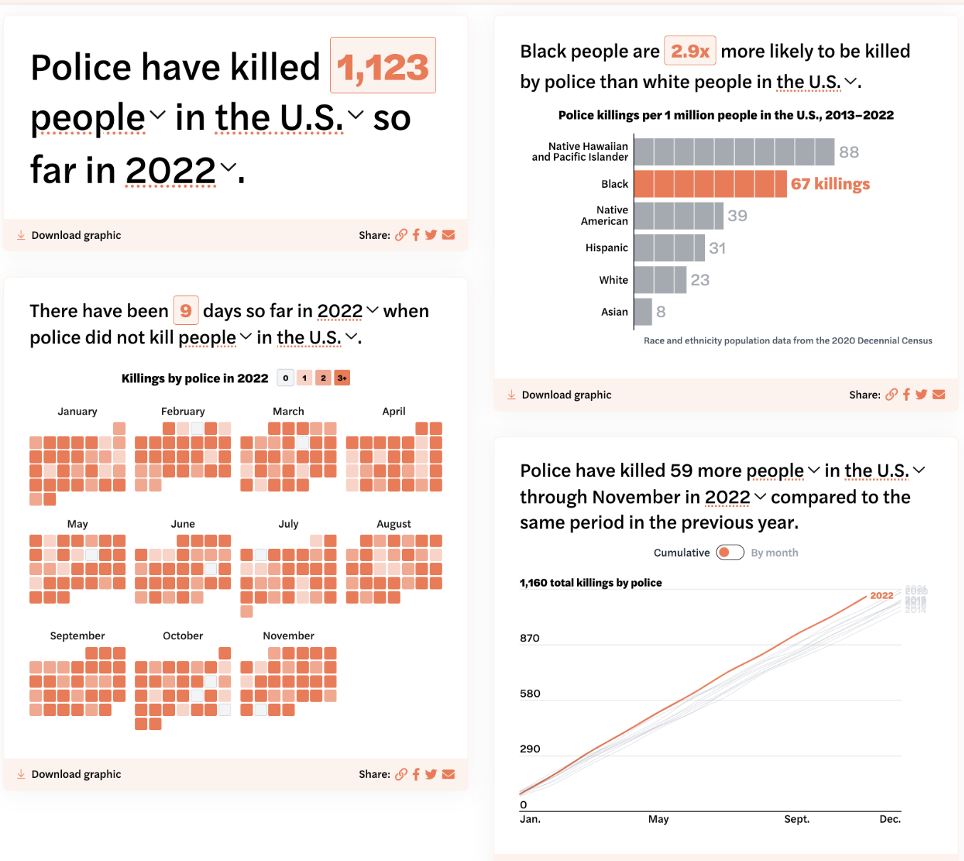
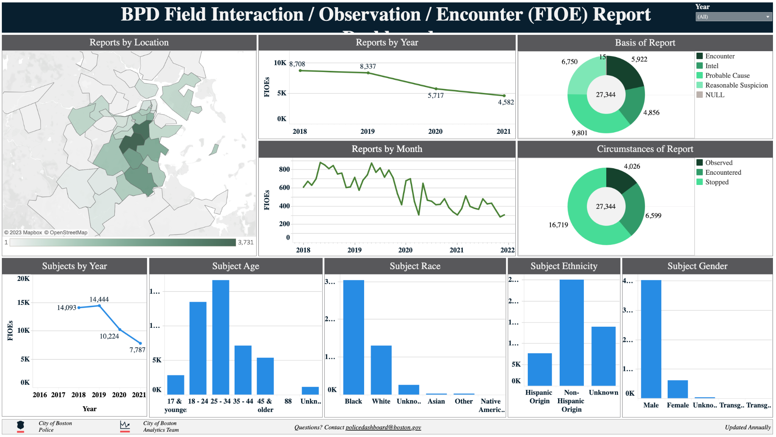
Inspiration
https://www.boston.gov/civic-engagement/boston-police-accountability-and-transparency-data
https://mappingpoliceviolence.org/

Slide 9
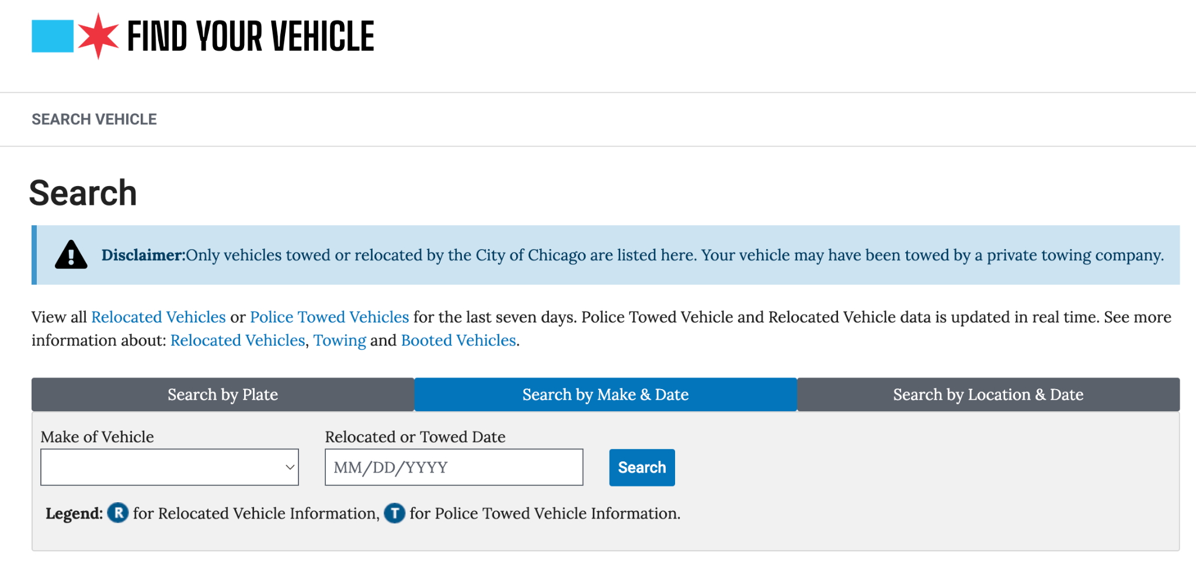
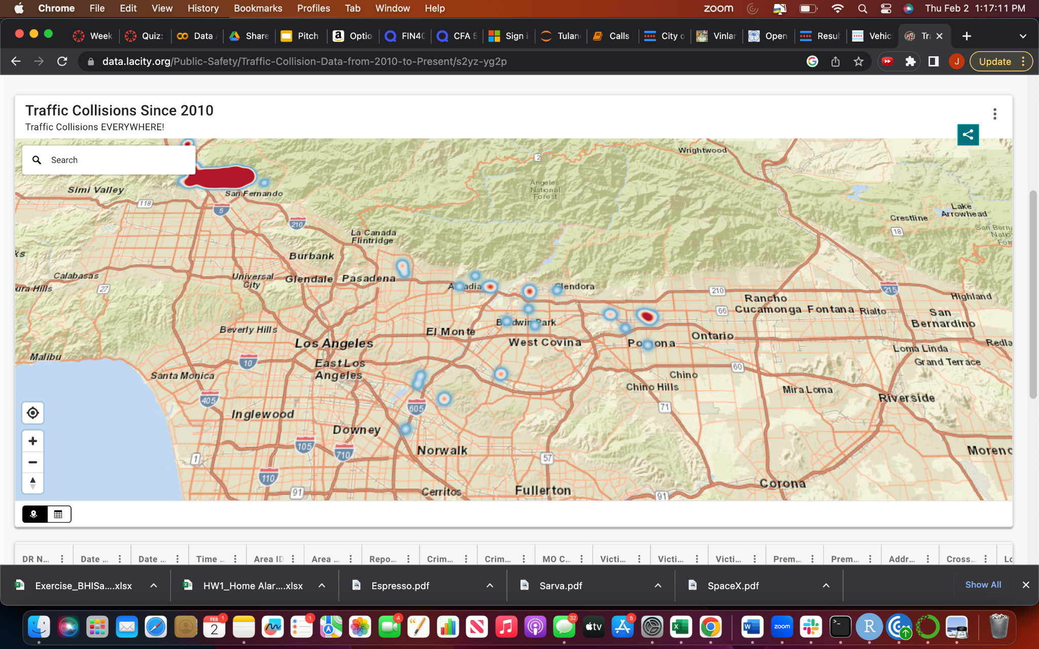
Inspiration from other Cities
Towed Vehicle Search/Map
Allow citizens to search for a vehicle they believe may have been towed
Mapping of where vehicles were towed
Traffic Collision Data
Mapping of accidents
Details of accidents by area

